Slide 1


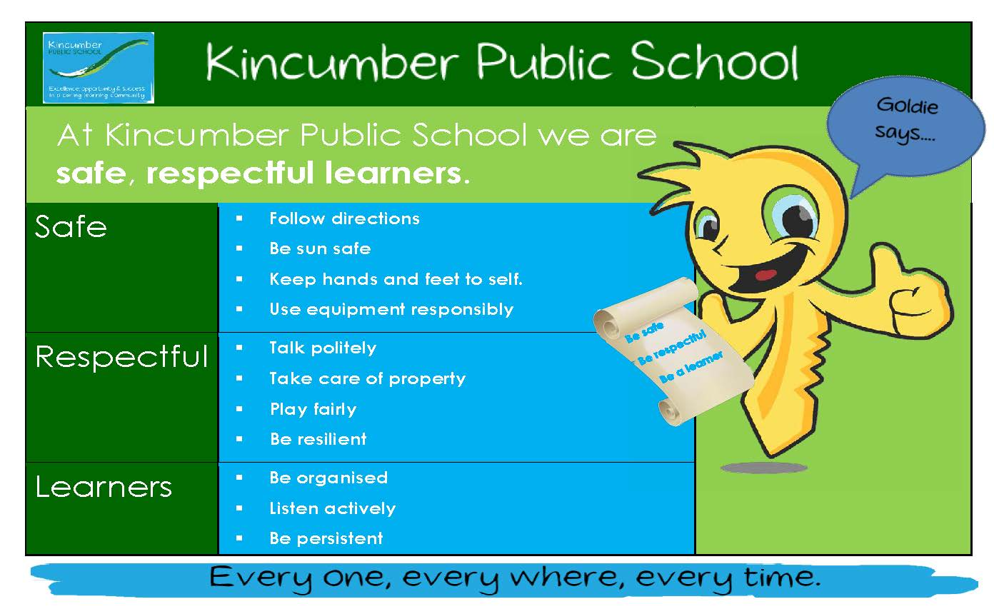
What it means to be ‘Safe’
At Kincumber Public School we are Safe, Respectful Learners.

Slide 2
At KPS, we are safe, respectful learners.

Slide 3

When we are being safe we:
Follow directions
Be sunsafe
Keep hands and feet to self
Use equipment responsibly

Slide 4
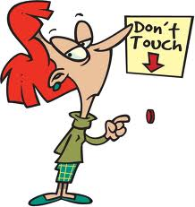
Today we are going to learn about our class “Safety Split”

Slide 5

What is a ‘safety split’?
There are times at school when we might need to leave an area to keep ourselves (and others) safe.
Your teacher may ask you to do a “Safety Split”. This means you need to leave the classroom (or other area) as quickly as possible and move safely to a classroom.

Slide 6
You might need a safety split when:
There is a risk to your safety in the classroom,
If the teacher is called away from the class,
If the teacher or a student has a medical problem and needs help.

Slide 7
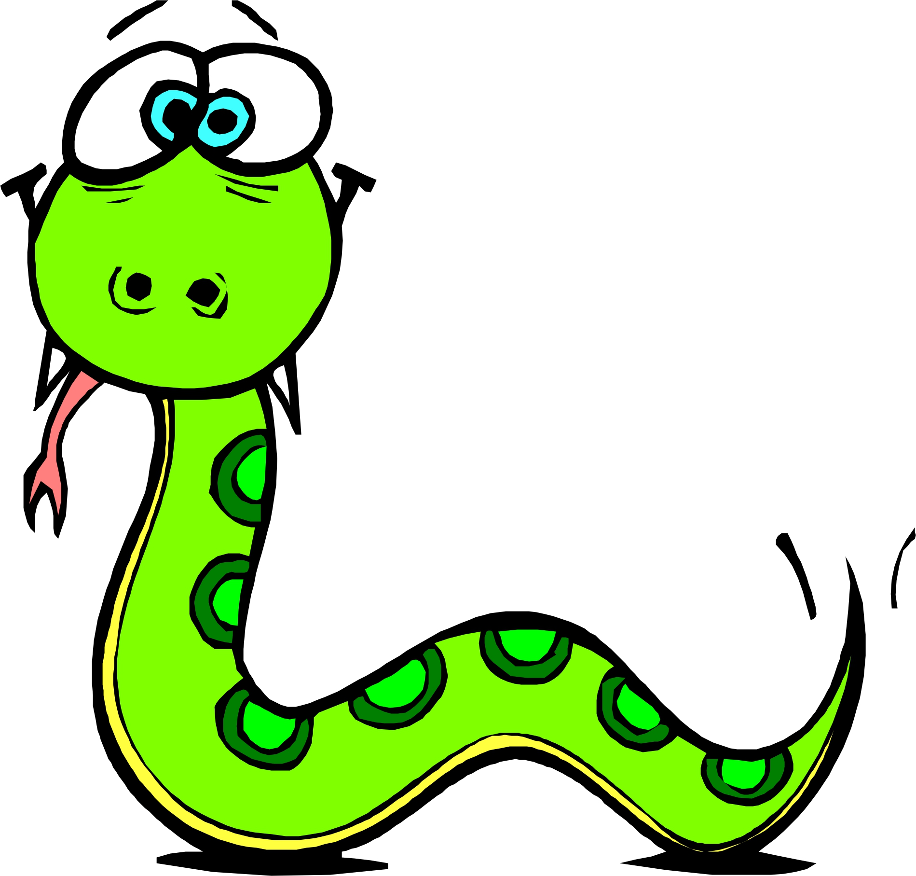
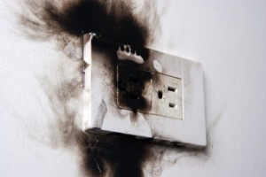

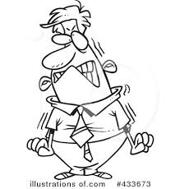
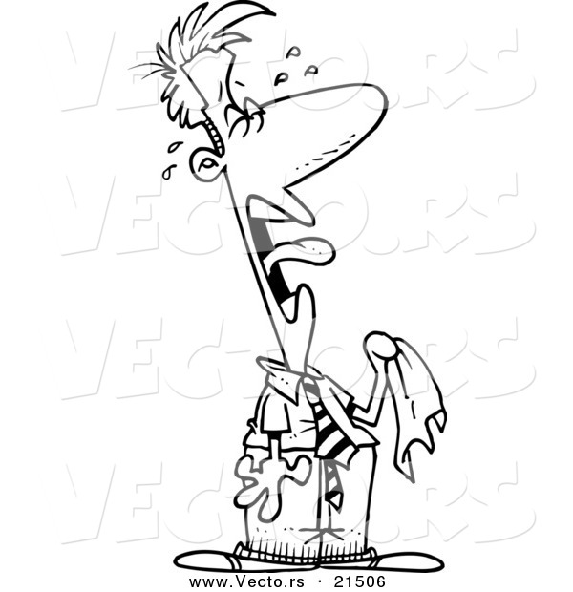
You might need a safety split if:
There’s a “visitor” in your room.
If there is faulty equipment that may be unsafe.
If someone needs medical attention.
If someone is very upset.

Slide 8
During a safety split: stay calm and follow instructions.
Your teacher will tell you if you need to go to your safety split class.
Stay calm and go straight away.
You don’t need to take anything with you.

Slide 9
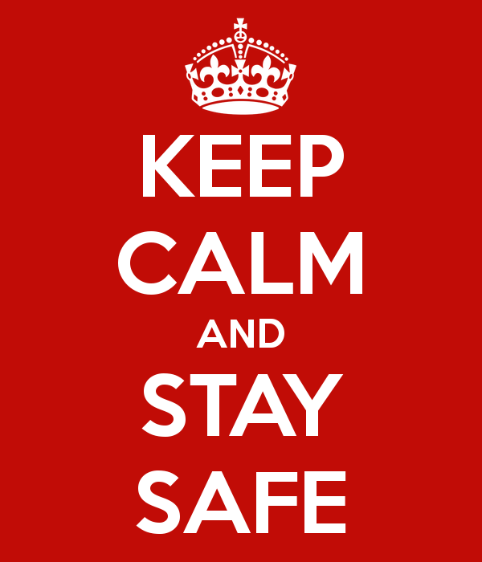
Be prepared.
Your teacher will give you lots of opportunities to practise a “safety split”. This means that you will be prepared and know what to do if there is a problem or emergency in the classroom.
Your teacher will tell you:
Which door to exit from,
What class you are going to,
How to move safely,
Why you need to stay calm and
What to do when you get there.

Slide 10

Remember:
Move quickly and safely.
Go straight to your safety split classroom. You don’t need to take anything with you.
Students are to leave their belongings (except their pencil case, if it is currently with the student). Do not stop to get belongings from anywhere else in the classroom. Do not stop to collect school bags/hats/jumpers etc. Exit the classroom/school setting quickly and walk calmly and quietly.
Know what class you are going to and what you need to do when you get there.

Slide 11


When you get there:
Go straight inside calmly.
Let the teacher know you have been sent to safety split classes.
Listen to teacher instructions.
If the class is not in the room, use the door sign to find out where they are. Move calmly.
Don’t panic. Go to the nearest classroom near you.

Slide 12

Time to role play!
Role play 1: follow emergency split procedures at school (remember that following instructions helps keep me safe!)
Role play 2: What do you do if it is unsafe to go through your classroom door?
Role play 3: what do you do when you get to your safety split class and they are not there?

Slide 13
Goldie says
Well done!
Now you know how to follow directions to help you stay safe at school.

Slide 14
At Kincumber Public School we are Safe, Respectful Learners.

