Slide 1
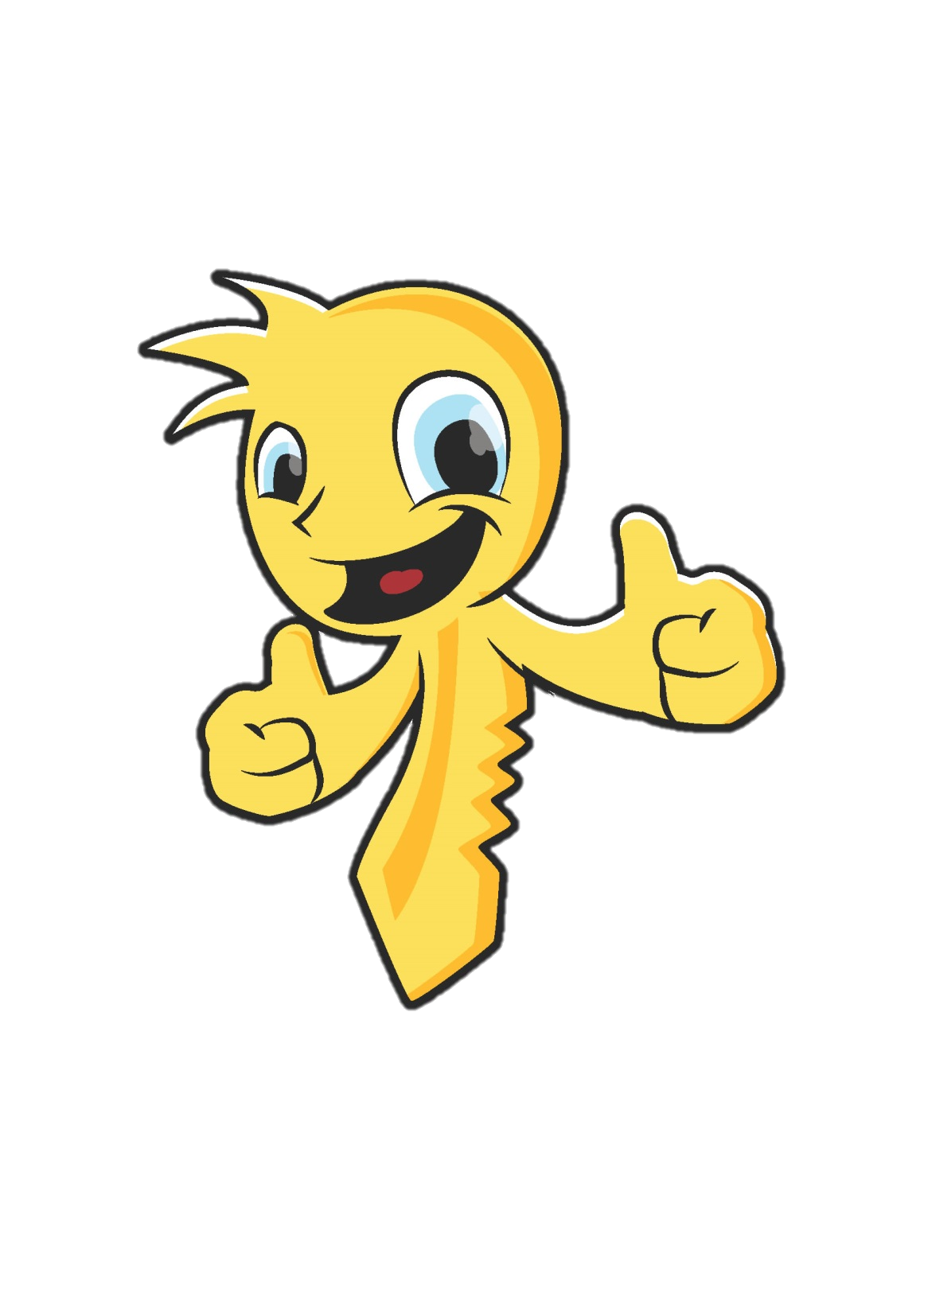

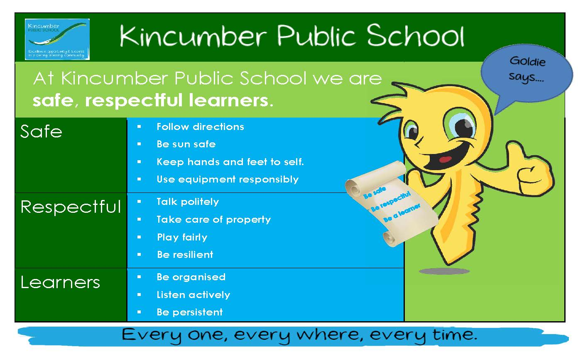
Bullying prevention:
At KPS we expect RESPECT

Slide 2
At KPS, we are respectful.
We expect others to be respectful to us.

Slide 3

Being respectful helps others to feel safe and happy and part of our school.

Slide 4

Safe, respectful learners don’t bully others.
Bullying is not okay.

Slide 5
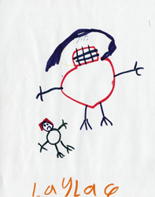
What is bullying?
Sometimes kids can be mean.
Sometimes kids can be rude.
Sometimes they can be bullies.
  It is important to know the difference
(but none of these things are okay).

Slide 6
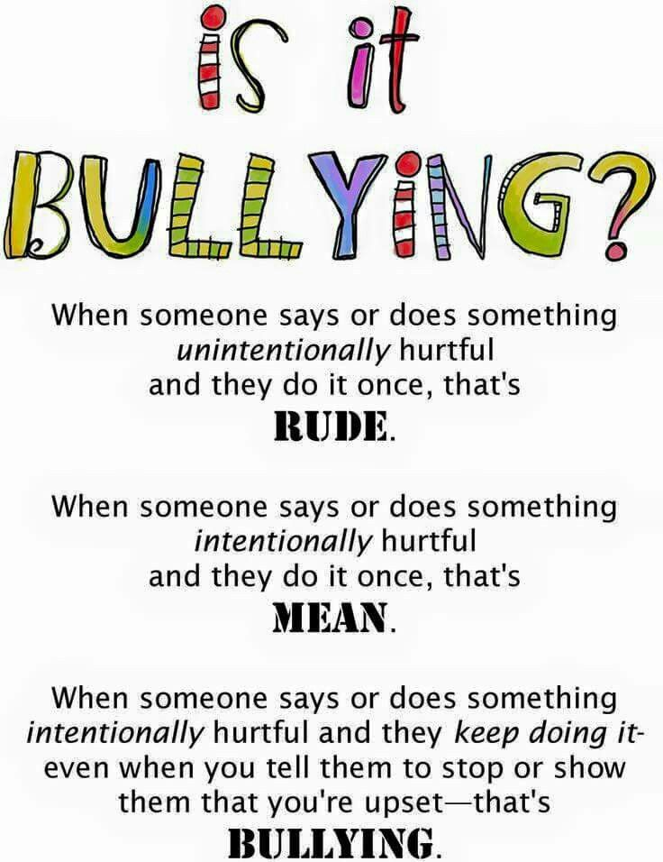

Slide 7
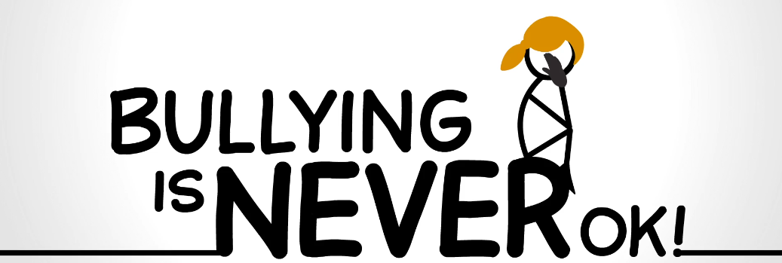
Bullying is never okay.

Slide 8

At our school we expect respect.
At KPS, we are respectful.

Slide 9

What does it mean to expect respect?
At our school, we are safe respectful learners. When we are respectful, we:
Talk politely
take care of property (and the feelings of others)
Play fairly.
At KPS we are respectful. We expect others to respect us.

Slide 10
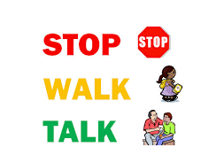
Bully prevention: stop, walk, talk.
If someone is disrespectful to you, say STOP.
If you see someone being disrespectful to others, tell them to STOP.
If the person stops, say “okay” or “cool” and move on with your day.
If the person does not stop, decide whether you should walk or talk (Walk away and Talk to an adult)

Slide 11
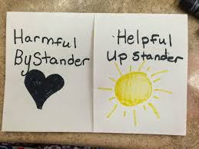
Bystander or upstander?
A bystander just stands by and watches someone be disrespectful to another. They don’t do or say anything.
An upstander stands up for others, or tells an adult if they see someone being disrespectful.

Slide 12


Bystander or upstander?
Which will be?

Slide 13

Bystander or upstander?
Which will be?

Slide 14

Be an upstander!
If you see someone being disrespectful to another, use the word STOP and encourage the child who needs your help to walk away with you and leave the area.
Tell a teacher.

Slide 15
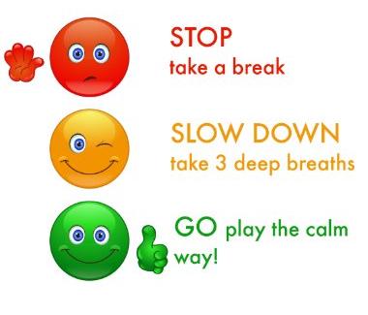
What if someone tells you to STOP?
Stop what you are doing, even if you don’t think you are doing anything wrong.
Be resilient. Remind yourself that “it’s no big deal to stop what I’m doing.”
Say “OK” to the person who
asked you to stop and move
on with your day.
Make a respectful choice!

Slide 16
Ways to say “STOP”
That’s not okay. You need to stop now.
You’d better stop.
Please stop that!
YOU NEED TO STOP THAT!
Stop it, I don’t like it.
That’s not respectful. You need to stop.
Hey buddy, stop that.
Stop. You’re not being respectful.
Stop and make a good choice
STOP NOW!
Stop, think choose!

Slide 17
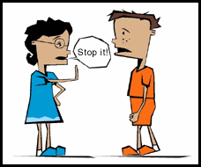

Be an upstander!
Stop. That’s not okay.

Slide 18
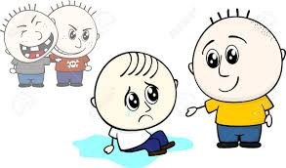
Be an upstander!
Let’s get out of here

Slide 19
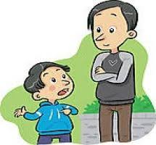
Be an upstander!
Let’s go tell a teacher.

Slide 20
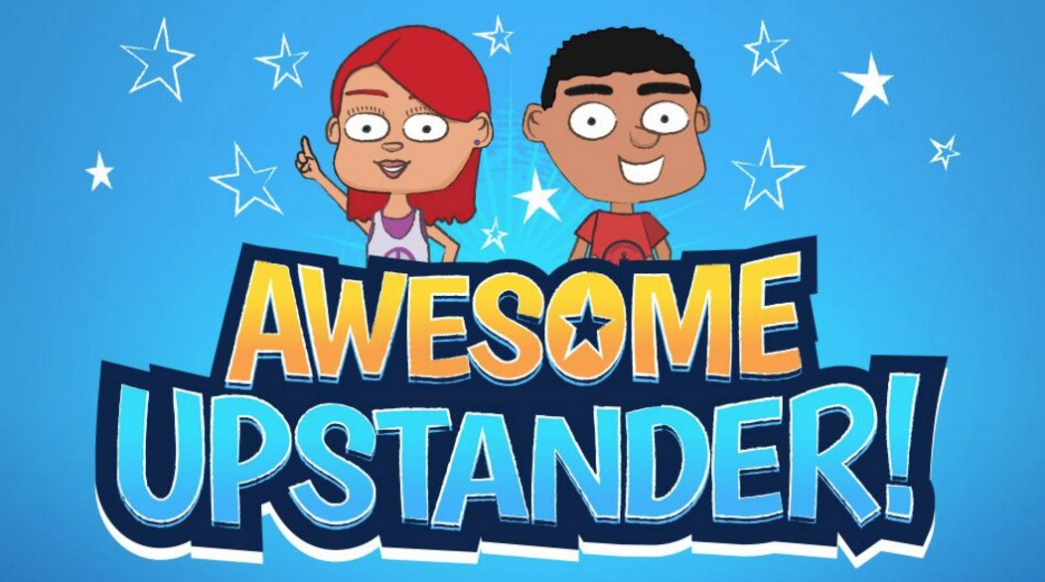
Your turn
You teacher is going to role play for you. They will pretend to be rude, mean or a bully to you. What would you do or say?
You teacher will pretend to be rude, mean or a bully to someone else. How could you be an upstander?

Slide 21
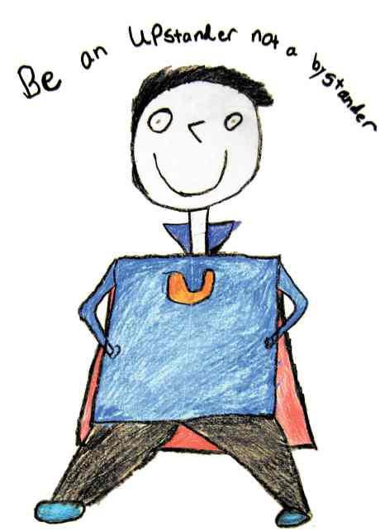
Goldie says
Well done!
Now we all know how to be respectful.
We know that we all deserve to be treated with respect.
We know how to STOP, WALK AND TALK.
And,we know how to be an upstander!

